Slide 1
Florida Elder Health Justice in the Time of COVID
June 29, 2020
Miriam Harmatz, Executive Director, Florida Health Justice Project
Katy DeBriere, Legal Director, Florida Health Justice Project
Sarah Halsell, State Legal Services Developer, Florida Department of Elder Affairs
Michael Phillips, North Regional Ombudsman Manager, Florida Long-Term Care Ombudsman Program
Toby Edelman, Senior Policy Attorney, Center for Medicare Advocacy
Melissa Lipnick, Law Clerk, Florida Health Justice Project
Notes:
]

Slide 2
Objectives for Session 1
Identifying Resources and Allies
Overview of Medicaid Eligibility for Florida Seniors
COVID-19 Medicaid Policies: Overview and updates
Long-Term Care Ombudsman: Current Nursing Home Crisis and Opportunities for Collaboration

Slide 3
Introductions
Melissa Lipnick, Law Clerk, Florida Health Justice Project
Katy DeBriere, Legal Director, Florida Health Justice Project
Sarah Halsell, State Legal Services Developer, Florida Department of Elder Affairs
Michael Phillips, North Regional Ombudsman Manager, Florida Long-Term Care Ombudsman Program
Toby Edelman, Senior Policy Attorney, Center for Medicare Advocacy

Slide 5
LSC’s Justice Gap Report - 2017
Notes:
As Figure 2 shows, civil legal problems related to health and to consumer and finance issues affect more households than any other type of issue. Health issues, for example, affect more than two in five (41%) low-income households. The most common problems in this area include having trouble with debt collection for health procedures (affecting 17% of households), having health insurance that would not cover medically needed care or medications (17%), and being billed incorrectly for medical services (14%).
Among Senior households, 56% had at least one civil legal problem in the year leading up to the survey research. Health issues represented 33% of those problems. In fact, health issues were the highest percentage amongst all special populations surveyed, including households in rural areas, those with veterans and those with persons with disabilities.
While civil legal problems related to health issues and consumer and finance issues are the most commonly experienced problems among low-income Americans, they are not the problem areas most likely to get attention from a legal professional. As Figure 4 shows, people seek professional legal help for only 18% of their civil legal problems related to consumer and finance and for only 11% of those related to health.

Slide 6
What is the Elder Law Risk Detector?
The Risk Detector is a web-based legal health “check-up” tool that allows groups serving seniors to screen older adults for common legal issues and refer them to a partnering legal services program
These screenings can take place in home, organizational or community-based settings, or done over the phone
It currently screens for legal issues or vulnerabilities related to housing, health care, consumer, abuse, and financial exploitation.
The Risk Detector does not provide legal advice and its use does not form an attorney-client relationship between any parties

Slide 7
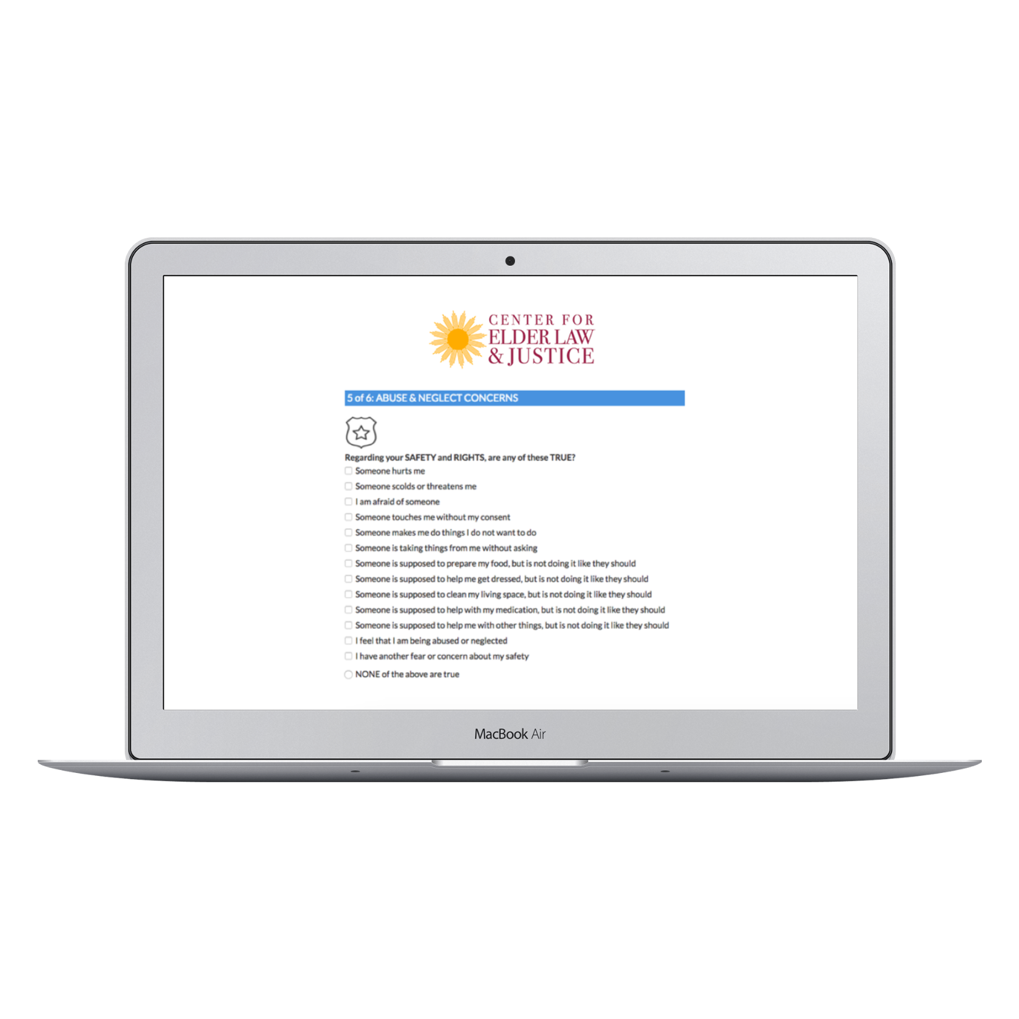
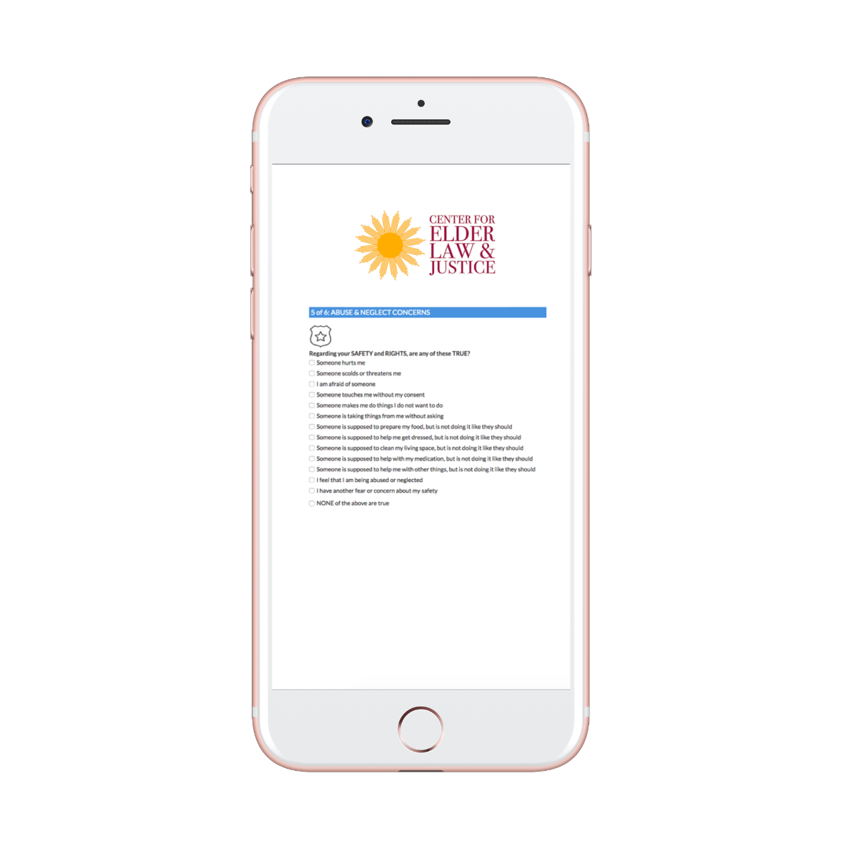
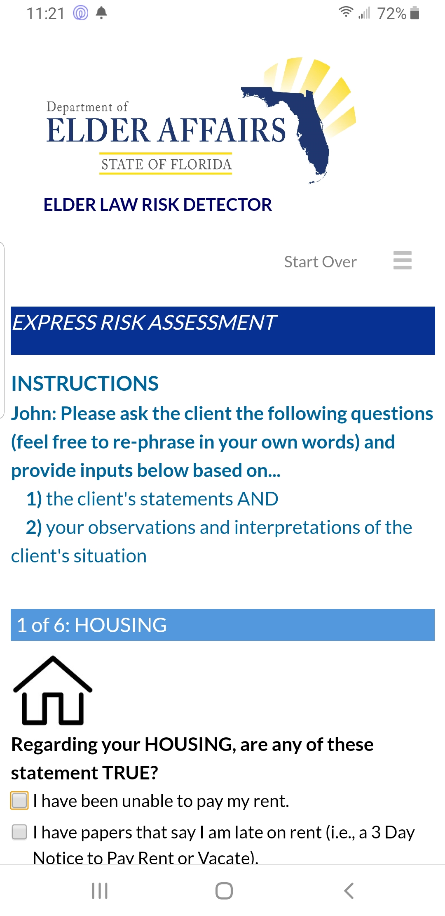
How does Risk Detector work?
The Risk Detector is a web-based application that can be accessed via a link using any device type – a computer, tablet or phone

Slide 9
Medicaid Eligibility for Seniors Overview
Organization of Florida’s Medicaid Program
Common Medicaid Eligibility Categories for Seniors
Rights & Protections for Applicants & Enrollees
Temporary Changes Due to COVID-19

Slide 10
Administration of FL’s Medicaid Program
State Plan
Each state implements its own Medicaid plan in compliance with federal statute and regulations, see 42 U.S. C. §§1396 et seq.; 42 C.F.R. §430.10
Florida’s state plan & amendments: http://ahca.myflorida.com/medicaid/stateplan.shtml
All amendments approved by Centers for Medicaid & Medicare Services
Single state agency: Agency for Health Care Administration (AHCA), Fla. Stat. §409.902; see also, A.H.R. v. Washington State Health Care Authority, No. C15-5701JLR, 2016 WL 98513 (W.D. Wa. January 7, 2016)(finding no Rule 19 joinder of MCOs as necessary party).
Chapter 409 of Florida Statutes
Florida Administrative Code: Rules 59G, 65-2, 65A-1
Eligibility for State Plan Medicaid: Department of Children & Families (DCF)
Eligibility for Long Term Care Waiver: Department of Elder Affairs (DOEA)/DCF

Slide 11
Technical Requirements for Eligibility
Technical requirements
Status
U.S. citizens
Qualified immigrant status: 5 year wait period unless meet exception or under age 19. See 8 U.S.C. §1613(b); 42 U.S.C. §1396b(v)(4)(A); Fla. Stat. §409.904(8)
No coverage for unqualified immigrants except Emergency Medical Assistance to Aliens (EMA). See Fla. Stat. §409.904(4); Rule 65A-1.715, F.A.C.
Residency: intent to remain; temporary absences fine
Category (“worthy poor”) – but see, Medicaid expansion
Numerous eligibility categories adopted by Florida state plan: http://ahca.myflorida.com/medicaid/stateplan.shtml; Fla. Stat. §§ 409.903 & 904
Income and Asset Requirements
Rules depend on the category of eligibility
ACA: no asset requirements for children & caretakers

Slide 12
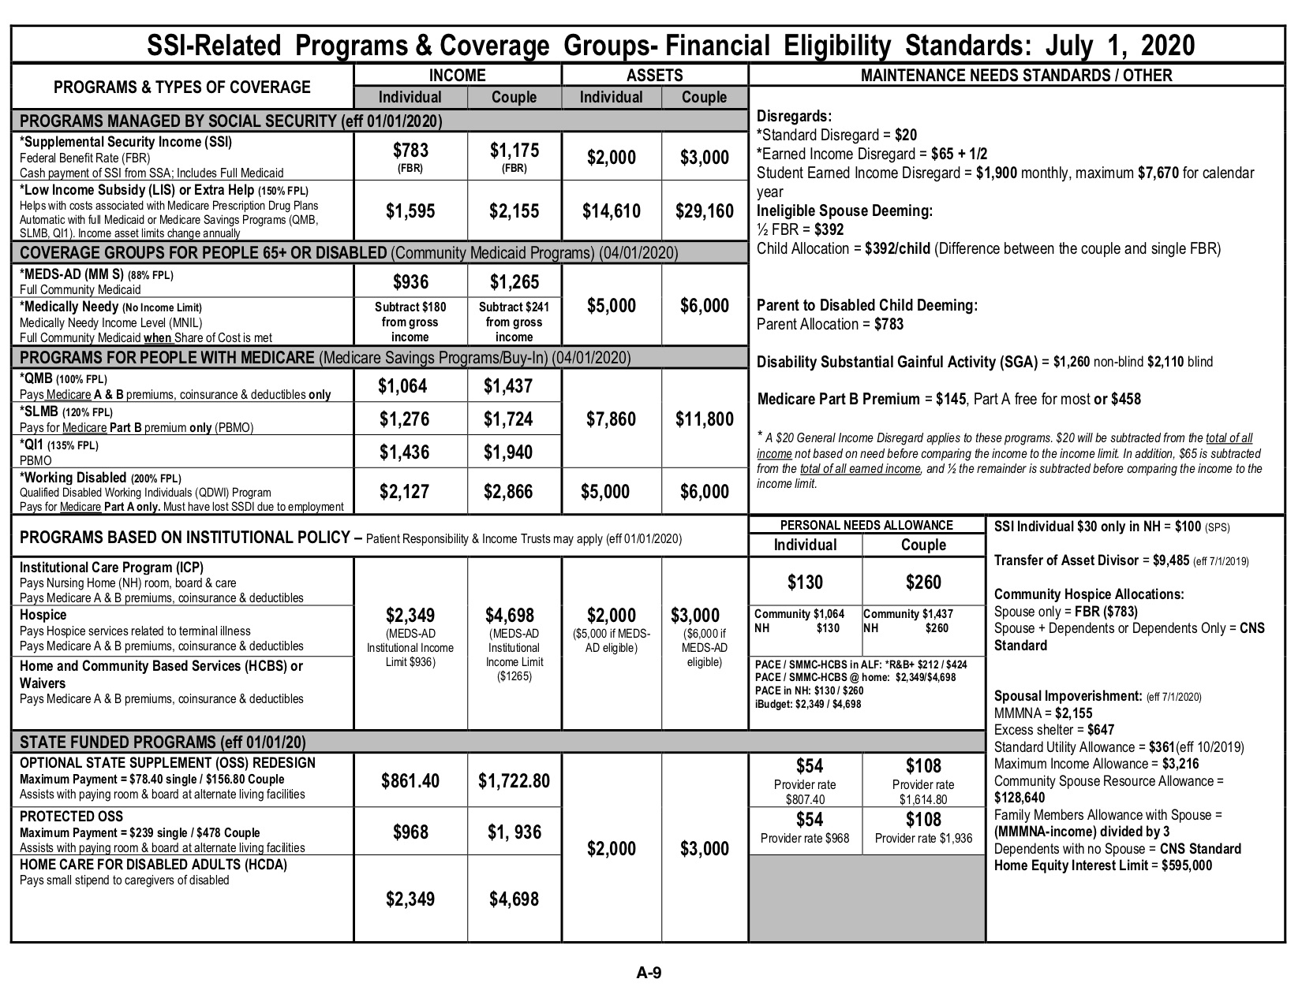

Slide 13
Common Eligibility Categories for Seniors
Receipt of Supplemental Security Income (SSI)
MEDS for Aged & Disabled (MEDS-AD)
Protected Medicaid
Widows
Pickle People
Disabled Adult Children
Medicaid Waivers (SMMC LTC Waiver)
Medicare Savings Programs
Qualified Medicare Beneficiary
Special Low-Income Medicare Beneficiary
Qualifying Individuals
Medically Needy for SSI Related

Slide 14
Receipt of SSI
Technical Criteria
Aged, Blind or Disabled
Aged = 65 or older
Disabled = Meet or equal an SSA Adult Listing
Application: Social Security Administration
Income Limit: $783 (individual), $1,175 (couple)
Asset Limit: $2000 (I); $3000 (C)
Full State Plan Benefits

Slide 15
MEDS-AD
Technical Criteria
Aged or Disabled
Not Medicare enrolled unless also receiving hospice, ICP, or HCBS
Application: Department of Children and Families
Income Limit: $936 (I); $1,265 (C)
Asset Limit: $5000 (I); $6000 (C)
Full State Plan Benefits

Slide 16
Protected Medicaid
Widowers
Technical Criteria
Not Medicare Part A eligible
Receipt of SSI 9prior to age 60) in month before Widowers
Or eligible to receive Title II as disabled widower
Income Limit: same as SSI Receipt but disregard Title II benefit amount
Asset Limit: same as SSI Receipt
Pickle People: https://www.tnjustice.org/wp-content/uploads/2011/03/2017-Pickle-chart-revised-re.-209b-listing-12-22-16.pdf
Disabled Adult Child
Technical Criteria: receipt of SSI in month before DAC
Income Limit: same as SSI related but disregard DAC benefit
Asset Limit: same as SSI Related
Full State Plan Benefits

Slide 17
Statewide Medicaid Managed Care Long Term Care Waiver
Technical Criteria
Aged/Disabled
Nursing Facility Level of Care
Application
DOEA/ADRC: 701S assessment
DCF: income/asset eligibility
Waitlist
Expedited Enrollment Criteria, §409.979(f), Fla. Stat.
NF resident requesting transition after 60 days or more in NF
APS referral at high risk with temp ALF placement by DCF
Income Limit: $2349 (I); $4698 (C)
Asset Limit: $2000 (I); $3000 (C)
Full State Plan Benefits + Home and Community Based Services

Slide 18
Medicare Savings Program Qualified Medicare Beneficiary
Technical Criteria: enrolled in Medicare Part A
Income Limit: $1,064 (I); $1,436 (C)
Asset Limit: $7,860 (I); $11,800 (C)
Benefits depend on status
QMB+: SSI Eligible + QMB Eligible = Full State Plan Benefits + Medicare Premium Assistance
QMB: Medicare A & B Premium Assistance; coinsurance & deductibles

Slide 19
Medicare Savings Programs Special Low-Income Medicare Beneficiary/Qualifying Individual 1
Special Low Income Medicare Beneficiary
Technical Criteria: Medicare Part A enrolled
Income Limit: $1,276 (I); $1,724 (C)
Asset Limit: $7,860 (I); $11,800 (C)
Premium Assistance with Part B only
Qualifying Individual 1
Technical Criteria
Medicare Part A Enrolled
Not Medicaid eligible
Income Limit: $1,436 (I); $1,940 (C)
Asset Limit: $7,860 (I); $11,800 (C)
Premium Assistance with Part B only

Slide 20
Enrollees Rights & Protections Applications
“No Wrong Door:” in person, phone, mail, DCF ACCESS, SSA, www.healthcare.gov
Reasonable promptness: 42 U.S.C. §1396a(a)(8); 42 C.F.R. §435.911; 65A-1.205, F.A.C.
45 days, 90 if disability determination
No SSI application required: CFOP 165-22, Chapter 1400, Section 1440.1400
Due Process Protections: written notice & opportunity to be heard
Denial or termination
DCF Office of Appeal Hearings: Rules 65-2, F.A.C. (except LTC Level of Care – see next slide)
Discovery
In-person

Slide 21
DOEA/ADRC LTC Waiver Level of Care Eligibility
After 701S Assessment, applicants are to be notified in writing of outcome, 59G-4.193(d), F.A.C.
Priority rank
Change to waitlist placement; Fla. Stat. §409.979(3)
Opportunity to appeal decision: AHCA Medicaid Fair Hearing Office
Waiver enrollment: once a space is opened and application process complete
Must receive denial in writing
Opportunity to appeal if denied: DCF OAH

Slide 22
Renewals/Ex Parte Reviews
Must renew eligibility annually with DCF
If LTC Waiver enrolled, managed care organization required to provide renewal assistance per Model Contract (https://ahca.myflorida.com/Medicaid/statewide_mc/model_health_FY18-23.shtml)
If Medicaid eligibility not renewed, must receive written notice of termination with opportunity to appeal
Ex Parte: state must continue Medicaid eligibility without interruption until state determines individual not eligible for any category of Medicaid; 42 C.F.R. §435.930; Rules 65A-1.702(9), 65A-2.048, F.A.C.

Slide 23
Special Protections for Dual Eligibles
Low Income Subsidy
Duals automatically eligible and enrolled
May need to advocate to recognize LIS status: see, https://www.ncoa.org/wp-content/uploads/part-d-best-available-evidence-policy.pdf
If HCBS enrolled dual, then $0 copayment (see JIA factsheet: https://www.justiceinaging.org/wp-content/uploads/2019/09/Updated-Part-D-HCBS-Fact-Sheet-2019.pdf)
Qualified Medicare Beneficiaries:
QMB+ & QMB only: no balance billing! See: https://www.cms.gov/Outreach-and-Education/Medicare-Learning-Network-MLN/MLNMattersArticles/downloads/se1128.pdf

Slide 24
Elimination of Retroactive Medicaid Eligibility
Retroactive Medicaid Eligibility: coverage of unpaid medical services 90 days retroactive to the date of a Medicaid application
Florida eliminated RME in 2018 for non-pregnant adults (although ongoing monitoring of impact)
Be sure to appeal a denied Medicaid application especially if for reasons like failure to provide verification

Slide 25
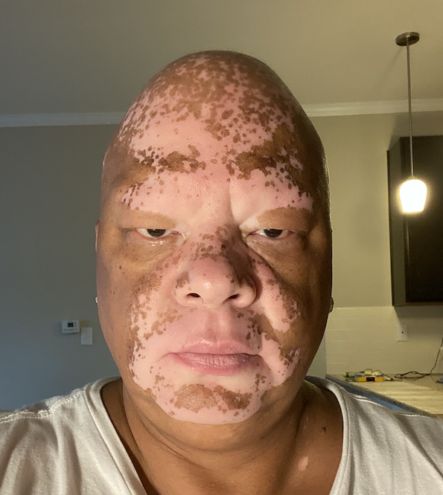
Importance of Story Sharing
George, a 56 year-old truck driver and native of Pennsylvania moved to Florida in 2019 to be closer to his daughter. He had suffered heart problems in the past and hoped that the move to Florida would decrease his stress levels.
Read George’s story here: https://www.floridahealthstories.org/george
Read about the repeal of Retroactive Medicaid Eligibility: https://www.floridahealthjustice.org/publications--media/repeal-of-retroactive-medicaid-eligibility-update-june-2020

Slide 26
COVID-19 Medicaid Updates
Provider Protections
Consumer Protections
Untapped Opportunities

Slide 27
Major Medicaid Consumer Protections
Suspension of terminations
can switch category of eligibility but only if same amount, duration and scope of benefits (i.e., can’t switch from MEDS-AD to QMB only)
No termination even if no longer meet LOC
Extension of time to provide verifications – 120 days
Recertification extended by 6 months
Waiver of service limits for COVID patients
Waiver of prior authorization for behavioral health

Slide 28
Potential Resources/Flexibilities
COVID-19 testing and treatment:
State option to provide testing for uninsured with 100% federal funds
State option to provide temporary Medicaid coverage for COVID-related diagnoses for uninsured individuals
Florida not (yet) exercised either option
HCBS services through 1915(c) waivers:
Appendix K
State option to increase waiver slots; services; front line worker pay
Notes:
State option to provide testing for uninsured with 100% federal funds
State option to provide temporary Medicaid coverage for COVID-related diagnoses for uninsured individuals
Florida not (yet) exercised either option

Slide 29
Appendix K
What is it?
Why is it important?
What can you do now?

Slide 30
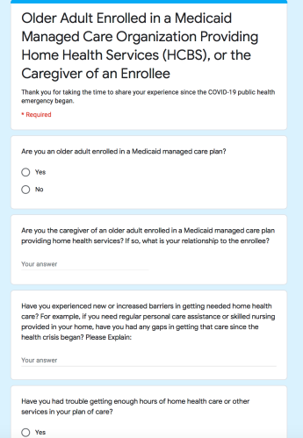
Stakeholder Questionnaires

Slide 31
Hypothetical
Jorge is an 85-year old man who receives MMA and LTC through his managed care plan He is in a wheelchair and requires a nursing home level of care. He went to visit his sister in Mexico for a month; because of COVID plane back canceled and had to stay extra months. When he returned his LTC benefits, including meals on wheels and home health services, were terminated. His niece, who has Power of Attorney and gets all his notices says she never got a written notice of the HCBS ending. She said that his Medicaid remains in effect. When she called plan to ask what happened, was told: “looks like terminated because out of country (not a resident).and did not show met LOC at redetermination time.”
Should this have happened during COVID/after COVID?
How can you help him get his HCBS benefits reinstated?
Notes:
-answer:
Should not have happened; What are some issues to flag?
lack of notice
Wrong reasons for termination
During COVID—should not happen. Protecting under the FFCRA --since state took in increased FMAP, cannot terminate—even if did not meet LOC.
After covid—residency as reason for termination wrong.
Get help through local ADRC! Quickly fixed for real case in Miami.

Slide 32
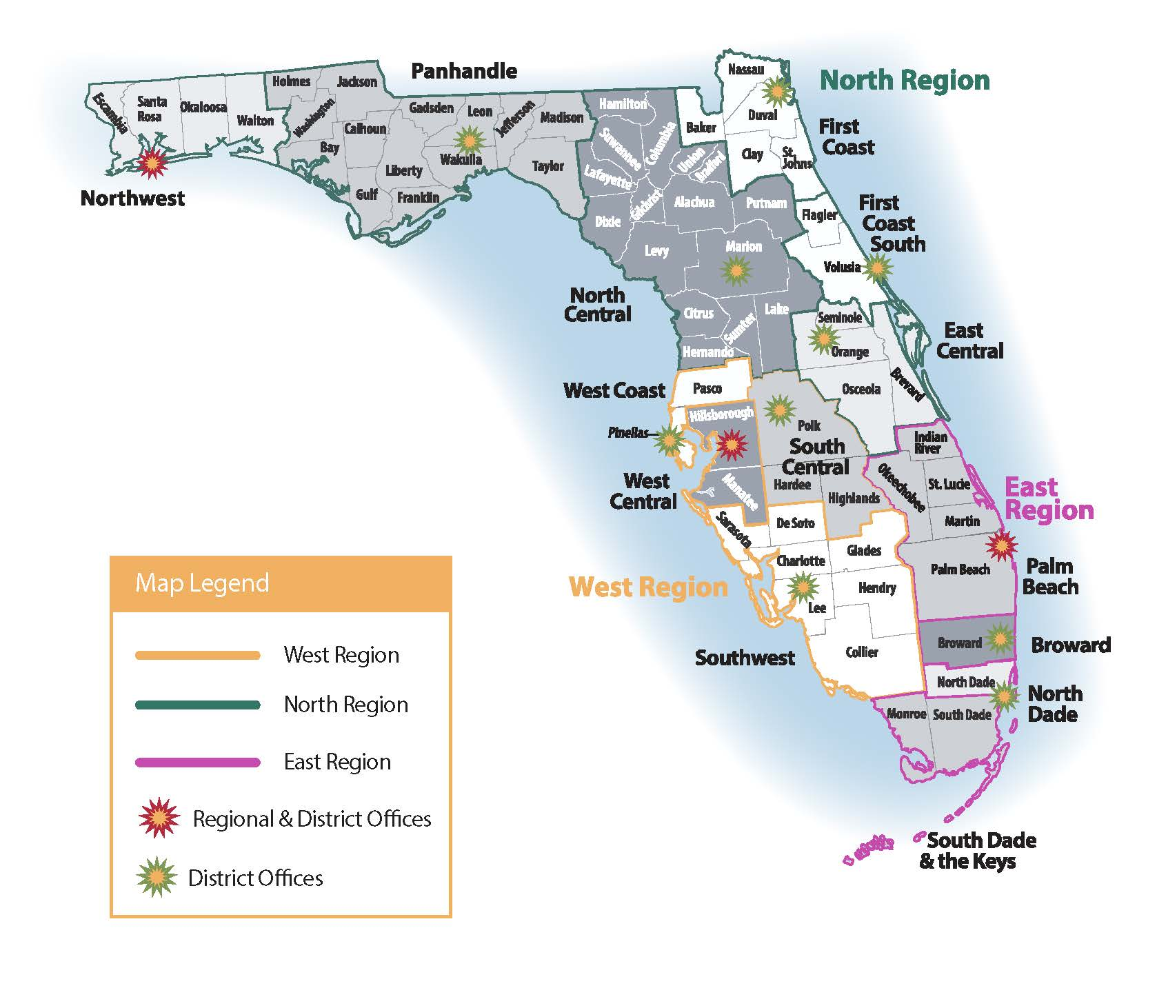
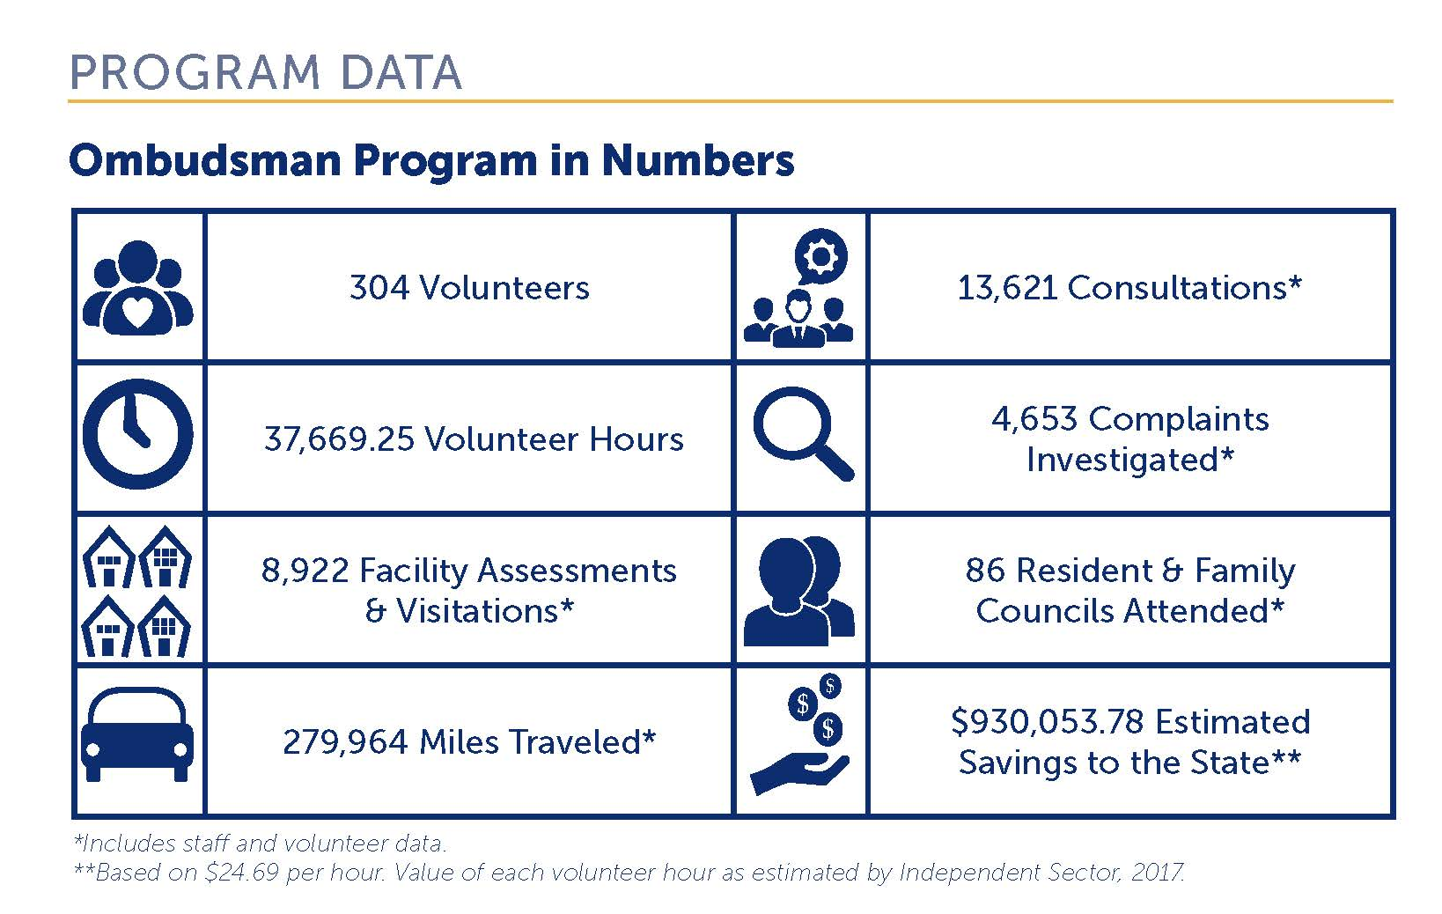
Description of FL LTC Ombudsman program
Mission Statement:
“The mission of the Florida Long-Term Care Ombudsman Program is to improve the quality of life for all Florida long-term care residents by advocating for and protecting their health, safety, welfare, and rights.”
3 Regions: North, East, West
18 Districts

Slide 33
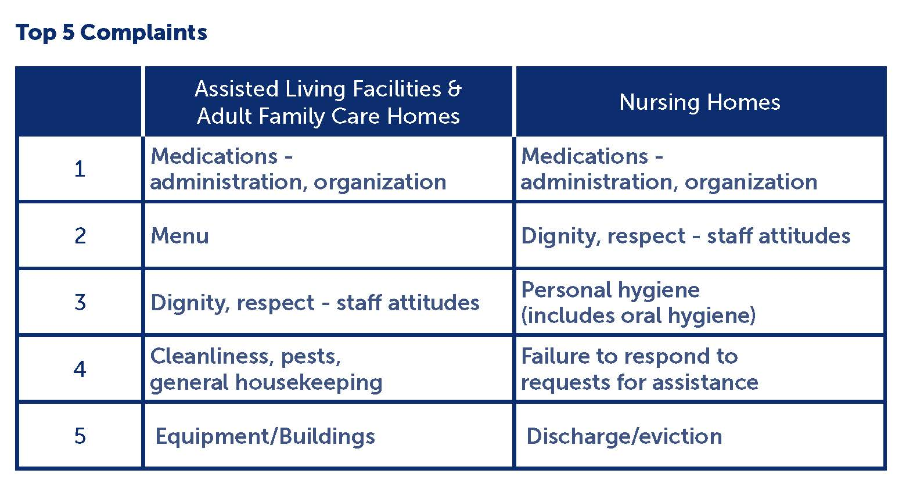
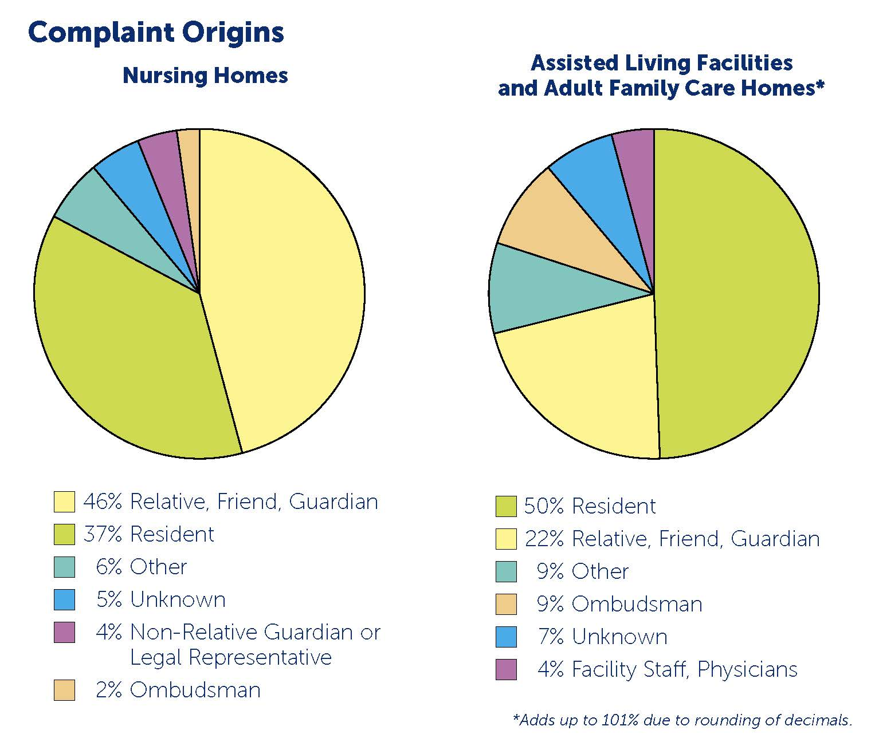
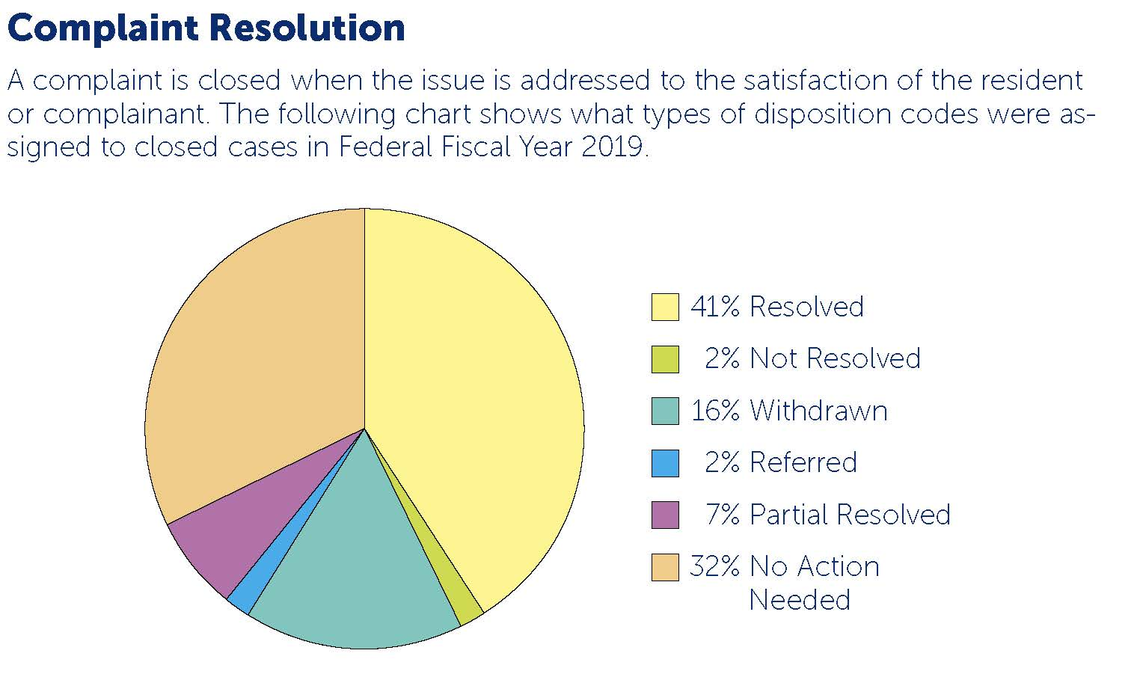
Nursing Home Conditions, Concerns, Issues Pre-COVID

Slide 34
COVID-19 Concerns
Complaint/Issues
Challenges
Lack of Oversite provided by:
AHCA
Family & Friends
Ombudsman
Visitation/Isolation
Depression
Activities/Boredom
Behavioral Issues
Unnecessary Medications
Stockholm Syndrome
Failure to Thrive
Hygiene
Care & Services
Dignity & Respect
Medication
Discharges
Dietary

Slide 35
Next Steps for LTC Ombudsman:
Investigate on Site
Document Issues
Pursue Appropriate Sanctions
A Variety of Moving Parts
APD
APS
Medicaid Fraud Control Unit
Department of Health (Licensure)
Legal Services

Slide 36
What can Legal Services do?
Meet local ombudsmen
Collaborate on investigations & enforcement actions when appropriate
Consider volunteering
Take referrals from local program e.g. discharges
Central Office Contact
Long-Term Care Ombudsman Program 4040 Esplanade Way, Suite 380 Tallahassee, FL 32399-7000
850-414-2323 or toll-free 1-888-831-0404 Fax: 850-414-2377 email: LTCOPInformer@elderaffairs.org

Slide 37
Stay Tuned for Part II

Slide 38
Resources
Florida Health Justice Project Website-Training Materials Page
Center for Medicare Advocacy
National Health Law Program (NHeLP)
Justice in Aging
Florida Long-Term Care Ombudsman Program
Kaiser Family Foundation
Florida Policy Institute: COVID-19 Safety Net Policy Tracker

