Slide 1
Florida Elder Health Justice in the Time of COVID
July 13, 2020
Toby Edelman, Senior Policy Attorney, Center for Medicare Advocacy
Miriam Harmatz, Executive Director, Florida Health Justice Project
Katy DeBriere, Legal Director, Florida Health Justice Project
Sarah Halsell, State Legal Services Developer, Florida Department of Elder Affairs
Michael Phillips, North Regional Ombudsman Manager, Florida Long-Term Care Ombudsman Program
Melissa Lipnick, Law Clerk, Florida Health Justice Project

Slide 2
Objectives of Session 2
Current and Ongoing Advocacy Issues in Nursing Homes
Staffing
Lax Enforcement
COVID-19 Issues
-Importance of link to Ombudsman Program
Overview of Florida Long-Term Care (LTC) Waiver
Available Services/Standards for Care
Most Recent Contract Changes
Consumer Issues, COVID Changes & Potential Advocacy Strategies

Slide 3
Pandemic
Nursing home residents account for nearly half of deaths nationwide; in some states, the majority of deaths are residents and staff.
Racial disparities are magnified in deaths from COVID-19, both in nursing facilities (residents and staff) and in general.
Florida, https://floridahealthcovid19.gov/

Slide 5
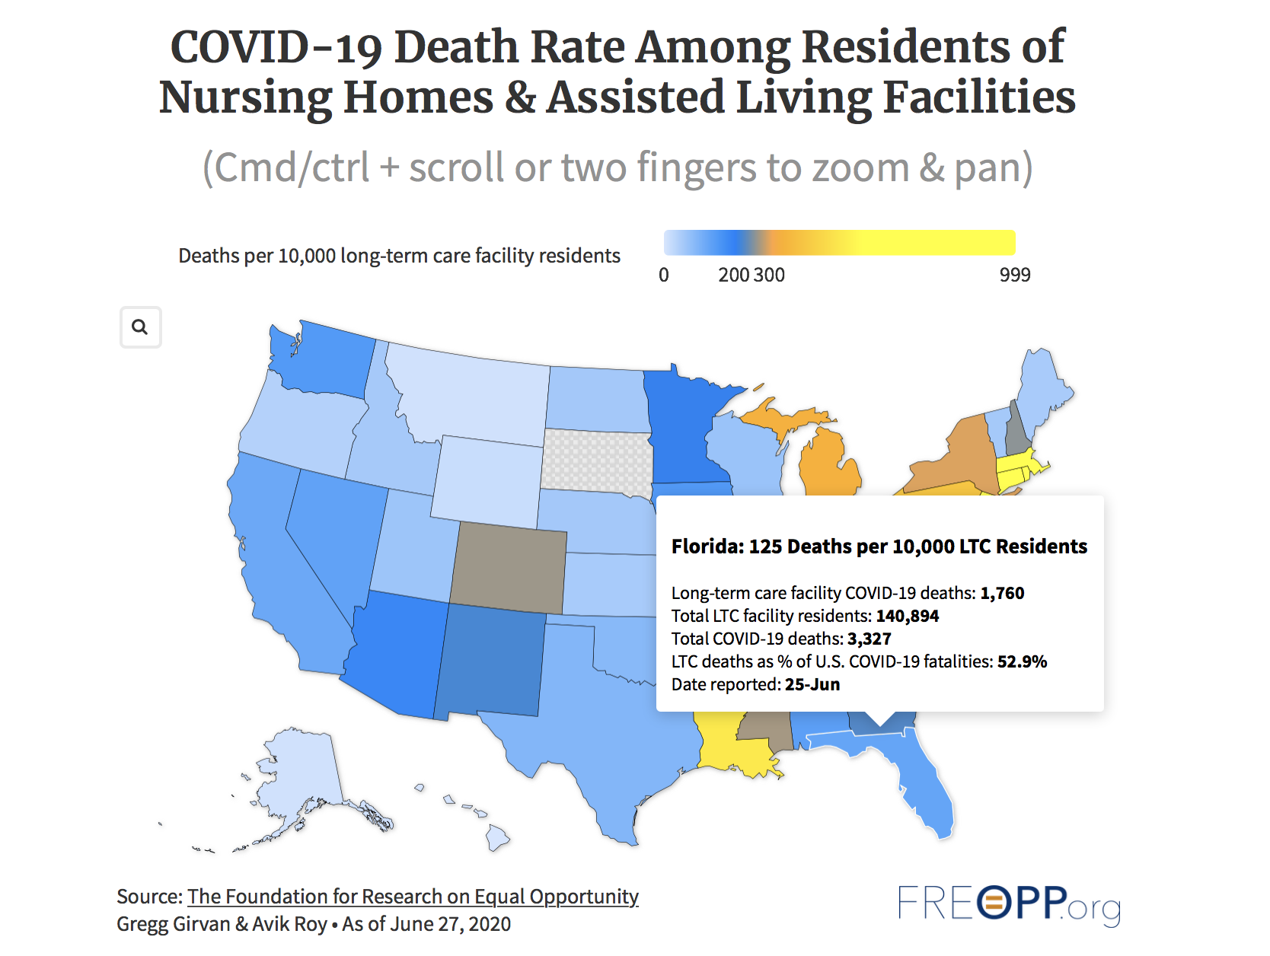
Nursing Home Deaths Florida
2,071 Deaths at Long-Term Care Facilities in Florida (July 13, 2020)
Deaths in Long-Term Care Facilities in Florida account for ~50% of total COVID-19 deaths
Notes:
1,931 Deaths at Long-Term Care Facilities in Florida (July 6, 2020)

Slide 6
COVID-19 Pandemic
Pandemic brought to public attention long-standing problems in nursing homes, including
Poor staffing levels
Poor infection prevention and control practices
Lax enforcement (of infection prevention and control rules and other federal standards of care).

Slide 7
Background of Federal Nursing Home Law
1987 Nursing Home Reform Law amended Medicare and Medicaid laws for facilities voluntarily choosing to receive federal reimbursement (nearly all), 42 U.S.C. §§1395i-3(a)-(h), 1396r(a)-(h)
Requirements of Participation (standards of care)
Survey process (to determine compliance)
Enforcement (penalties for deficiencies)

Slide 8
Requirements of Participation
Revised Oct. 2016 (first comprehensive revision in 25 years), 42 C.F.R. §§483.1-483.95
Most rules went into effect Nov. 2016 because they were identical, or very similar, to prior rules.
Proposed changes to reduce “burdens” of Requirements, 84 Fed. Reg. 34737 (Jul. 18, 2019)
Primarily to “new” Requirements from Oct. 2016, including
Eliminating the requirement that prescribing practitioner evaluate resident in person before renewing PRN antipsychotic drugs
Changing requirement that infection preventionist be on-site, from part-time to sufficient time.

Slide 9
Surveys
Unannounced standard (annual) and complaint surveys on 9-15 month cycle (averaging 12 months).
Surveyors are trained and must pass a test to conduct surveys.

Slide 10
Enforcement
Range of financial and other penalties for deficiencies (least implemented part of the Nursing Home Reform Law).
Financial penalties are typically limited to deficiencies called “harm” or “immediate jeopardy” (3-4% of all deficiencies).
Most noncompliance does not lead to any financial penalty.

Slide 11
Excellent Materials on Representing Residents
https://www.floridahealthjustice.org/materials.html
The Consumer Voice for Quality Long Term Care, theconsumervoice.org
Webinars, Friday at 2:00, on Nursing Homes and COVID-19
This Week’s Webinar: Staffing

Slide 12
Pandemic
In March 2020, CMS waived resident protections
Transfer/discharge rules if reason is “cohorting” (i.e., grouping residents by COVID-19 status).
But facilities actually discharging residents for other reasons without advance notice.

Slide 13
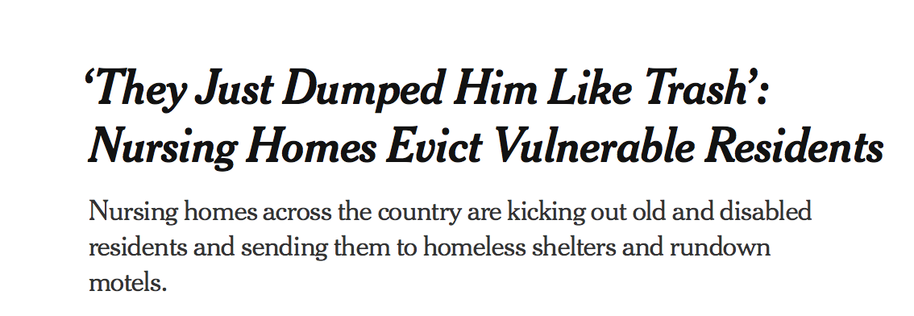
NYT ‘Dumping Article’
https://www.nytimes.com/2020/06/21/business/nursing-homes-evictions-discharges-coronavirus.html

Slide 14
Pandemic
No visitors (families, ombudsmen) since mid-March, except in “compassionate care” situations.
“Compassionate care” often narrowly interpreted to mean end-of-life
CMS now liberalizing definition
States now beginning to liberalize visitation.
As of July 8, Florida hasn’t.
https://floridahealthcovid19.gov/nursing-homes/

Slide 15
Nurse Aide Training Requirements
Waiver of 75-hour training for nurse aides, who provide most direct care to residents.
National nursing home trade association developed 8-hour on-line training program, which Florida and other states accept as sufficient.

Slide 16
Florida
“New temporary Personal Care Attendant program,” with “8-hour training on assisting with direct care so that personal care attendants can temporarily perform additional duties.”
www.floridahealth.gov/newsroom/2020/04/042020-1845-covid19.pr.html

Slide 17
What Happens to Aides After the Pandemic?
Fired?
Grandfathered in as permanent aides?
Required to get full training and pass competency evaluation test?

Slide 18
Elimination of Facility Reporting Requirements
Staffing information
Payroll-based staffing information not required (recently reinstated for second quarter 2020, but not for first quarter)
Resident assessment information
Information used to report Quality Measure domain on Nursing Home Compare

Slide 19
Surveys and Enforcement
CMS waived all standard and complaint surveys (since March) except
Targeted infection control deficiencies
Complaints and facility-reported incidents that states triage as immediate jeopardy (less than 1%).
CMS waived enforcement, except for immediate jeopardy.

Slide 20
Health Subcommittee of the House Ways and Means Committee Testimony
“I want to acknowledge the deaths of more than 50,000 nursing home residents and hundreds of nursing home staff from COVID-19. We grieve for residents, staff, and families who have been barred from visiting their relatives for more than three months.”
“These past several months have brought to fuller public awareness the deadly consequences of poor care, inadequate staffing levels, and treatment of regulations intended to ensure good care for residents as burdens on facilities that need to be eliminated. Although many of these problems in nursing facilities have been identified for decades, they have been made worse by recent deregulatory actions and the coronavirus pandemic. Essential changes are needed.”

Slide 21
Targeted Infection Control Surveys
5400+ surveys, from March (publicly released June 4, 2020)
163 surveys (less than 3%) cited infection control deficiency
161 deficiencies were “no harm”
Not plausible result, since infection control is #1 deficiency cited in nursing facilities.

Slide 22
GAO
GAO, Infection Control Deficiencies Were Widespread and Persistent in Nursing Homes Prior to COVID-19 Pandemic, GAO-20-576R (May 20, 2020)
82% of facilities were cited with infection control deficiency 2013-2017; 48% of facilities were cited in multiple years.

Slide 23
Facilities Cited with Infection Control Deficiencies
Poor ratings on Nursing Home Compare for surveys, staffing levels
More likely than non-cited facilities to be
Operated on a for-profit basis
To have had remedies of civil money penalties or denials of payment for new admissions imposed in prior 3 years
More like to be a Special Focus Facility (SFF) or SFF candidate

Slide 24
Immediate Jeopardy Surveys
June 4 release of survey reports included 20 immediate jeopardy surveys
Largely abuse, supervision
Facilities cited with abuse have poor survey histories and low nurse staffing levels, are more likely to be for-profit, had civil money penalties imposed in prior 3 years.

Slide 25
Concerns
Lack of care for residents (e.g., no baths for weeks; dehydration)
Untrained staff providing care
Indiscriminate transfers
No visits/oversight by families, ombudsman
Limited oversight by state survey agencies
No enforcement

Slide 26
What To Do
Connect with ombudsman program as staff and volunteers begin again to visit facilities
They know issues residents are concerned about and need help with
They know facilities’ histories and state agencies
Identify some key policy issues

Slide 27
Immediate Issues for Residents
Transfer/discharge issues (always #1 issue, worse now)
Residents can only be transferred/discharged for specified reasons, 42 C.F.R. §483.15(c)
Residents have rights to written notice and opportunity for administrative hearing (Medicaid agency)
Visitation

Slide 28
$1200 Stimulus checks
CARES Act authorizes economic impact payments (“stimulus checks”)
FTC Alert (May 15, 2020), https://www.ftc.gov/news-events/press-releases/2020/05/ftc-alerts-consumers-about-nursing-homes-assisted-living
States have received reports: nursing and assisted living facilities requiring residents on Medicaid to sign over checks to facilities.

Slide 29
CMS Press Release
“Nursing Home Residents’ Right to retain Federal Economic Incentive Payments” (Press Release, Jun. 11, 2020), https://www.cms.gov/newsroom/press-releases/nursing-home-residents-right-retain-federal-economic-incentive-payments
CMS has heard of allegations (but no specific complaints) that facilities “are seizing” residents’ checks.

Slide 30
CMS Analysis
Facilities’ taking checks violates
42 CFR 483.12, misappropriation of residents’ property
42 CFR 483.10, right to manage one’s own financial affairs (if required to deposit check with facility)

Slide 31
CMS Recommends
File a complaint with state survey agency.
CMS and state investigators will make referrals to State Attorneys General, as appropriate (that is, if they find a violation).
File a complaint with state Attorney General.

Slide 32
What About Florida?
Issues and arguments are both specific to Florida and universal.

Slide 33
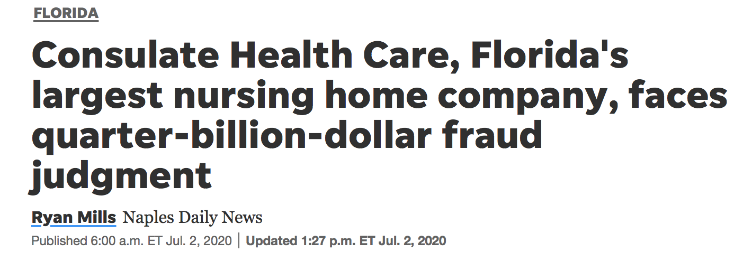
Notes:
https://www.naplesnews.com/story/news/special-reports/2018/02/22/neglected-florida-worst-nursing-homes-left-open-despite-history-poor-care-deaths/315924002/
https://www.naplesnews.com/story/news/special-reports/2018/05/31/floridas-largest-nursing-home-owner-part-growing-national-trend/581511002/
https://www.naplesnews.com/story/news/local/florida/2020/07/02/consulate-health-care-florida-fraud-reinstated-judgment-255-million/3278365001/
https://www.theledger.com/news/20180419/55-consulate-nursing-home-licenses-spared-in-agreement
Melanie Payne and Ryan Mills, “Neglected: Florida’s worst nursing homes left open despite history of poor care, deaths,” Naples Daily News (Feb. 2, 2018).
AHCA Secretary Justin Senior said,
“We are required by Florida law to take the least invasive, least intrusive licensure action that we can take under the circumstances, and in every single situation, whether it’s a small fine or whether it’s a moratorium or if it’s a suspension, our action is going to be reviewed and vetted.”
Although Secretary Senior said that fines are “‘generally enough’ to prompt improvement, State Senator Gary Farmer disagreed: “‘Here’s a reality of capitalism. If there is no financial disincentive, safety and responsibility tend to become just bottom-line numbers.’”
Naples Daily News reports that the average state fine is $5000 and the average federal fine (from 2013-2016), “$27,000 “although the Trump administration is scaling them back under a broad deregulation effort.”
“Neglected: Florida’s worst nursing homes left open despite history of poor care, deaths” is available at https://www.naplesnews.com/story/news/special-reports/2018/02/22/neglected-florida-worst-nursing-homes-left-open-despite-history-poor-care-deaths/315924002/ and from the Center for Medicare Advocacy, on request.

Slide 34
State Concerns
Are facilities prepared for hurricanes and loss of power?
Rehabilitation Center at Hollywood Hills, 12 residents died when facility lost power after Hurricane Irma (2017); license revoked.
Other facilities failed to install equipment for back-up power (2018).
Ownership (national concern, too)
Consulate Health Care, largest chain in state with more than 10% of facilities, is owned by private equity firm Formation Capital.
Settlement with state (Apr. 2018) about licensure dispute, when state had terminated Medicare and Medicaid contracts of 2 facilities and, under state law, could take licensure action against other facilities with same ownership; instead, 8 facilities put on 2-year improvement plan.
Problem with action against all licenses under common ownership: too big to fail.
11th Circuit reinstated part of jury verdict in False Claims Act case (Medicare and Medicaid fraud) (Jul. 2020),
Debates in Legislature about improving care/reimbursement.
Media interest.

Slide 35
Florida Law
Some unique provisions in Florida’s licensure law, Chapter 400
Actions against licenses, §400.102
Authority to mandate that additional staff be hired, §400.121(6)
Quality assurance/early warning system (analysis of financial, quality of care indicators), §400.118
Is it possible to file Freedom of Information Act request to find out whether and how state has used its authorities?
Is it possible to issue a report about findings?
Get media attention?
Would Legislators consider oversight hearing of how these provisions are implemented?

Slide 36
National Policy Advocacy
Public attention may create possibility of enacting better policies for the future
Staffing
Better enforcement
Better controls over ownership/management
Better accounting for public reimbursement (medical loss ratio)

Slide 37
Policy Advocacy Needs Resident/Staff Stories
Most successful advocacy hears from people with personal experience.
Congressional briefings and hearings have begun with families of residents who died, workers (limited testing, limited personal protective equipment, low salaries, limited or no paid sick leave), then others, including experts with data.

Slide 38
Staffing
Need RN coverage 24 hours/day
Yue Li, et al, “COVID-19 infections and deaths among Connecticut nursing home residents: facility correlates,” Journal of the American Geriatrics Society (Jun. 18, 2020),
https://onlinelibrary.wiley.com/doi/epdf/10.1111/jgs.16689
Facilities with higher RN coverage (20 more minutes per day) and higher star ratings less likely to have confirmed cases of COVID in Connecticut nursing facilities

Slide 39
Staffing
Aides need higher salaries and better benefits (e.g. paid sick leave)
Early on in pandemic, aides unknowingly transmitted COVID-19 among facilities (when they were contagious but asymptomatic) because they need to work multiple jobs.

Slide 40
Enforcement
99+% of infection control deficiencies called no harm.
Need to treat deficiencies as meaningful and to impose appropriate and meaningful sanctions.

Slide 41
Ownership/Management
Need tighter, more stringent rules for who gets state license to operate a facility, who gets federal certification (Medicare and Medicaid).

Slide 42
Medical Loss Ratio
Need to require nursing facilities to spend a designated portion of their reimbursement on care (not profits, overhead, administration)
Affordable Care Act implemented medical loss ratio for managed care plans.

Slide 43
Conclusion
We need to use the experience of COVID-19 to provide better care for residents, and to improve the lives of workers and their families, in the future.

Slide 44
The Center for Medicare Advocacy is a national, non-profit law
organization founded in 1986 that works to advance access to comprehensive Medicare and quality health care.
Based in CT and DC with additional attorneys in CA, MA, NJ.
_______________
Staffed by attorneys, advocates, and technical experts
Education, legal analysis, writing, assistance, and advocacy
Systemic change – Policy & Litigation
Based on our experience with the problems of real people
Medicare appeals
Medicare/Medicaid Third Party Liability Projects

Slide 45
For further information, to receive the
Center’s free weekly electronic newsletter, CMA Alert,
update emails and webinar announcements, contact:
Communications@MedicareAdvocacy.org
Or visit
MedicareAdvocacy.org
Follow us on Facebook and Twitter!

Slide 46
Hypothetical #1
Rehabilitation Center at Hollywood Hills, whose nursing home license was revoked following the deaths of 12 residents in the aftermath of Hurricane Irma in 2017, has sought review in the U.S. Supreme Court.
An investigative reporter with the Naples Daily News calls and asks your opinion. What do you say?
Notes:
Rehabilitation Center at Hollywood Hills, whose nursing home license was revoked following the deaths of 12 residents in the aftermath of Hurricane Irma in 2017, has sought review in the U.S. Supreme Court.
An investigative reporter with the Naples Daily News calls and asks your opinion. What do you say?

Slide 47
Home and Community Based Services (HCBS)
What are they?
Services needed to “meet functional needs and remain in community.”
How are they different from other Medicaid services?
Not entitlement
How are they provided in Florida?
Long Term Care Program Waiver
Notes:
LTSS—also referred to as HCBS are those services like home health aides, that are essential for people who are so frail and/or disabled who would otherwise need to be in institution
Different from regular Medicaid 2 ways: 1) not “medical "therefore not “covered under section of Medicaid Act that defines the medical services states must cover such as Rx, hospital services, doctors; HCBS by contrast include things like home health aide—; 2) there fore, have been made available by “waiving” that section of the Act defining medical services; and 2) they are not an “entitlement” unlike other parts of the Medicaid program where states must provide coverage and services to everyone who meets eligibility requirements.
IN Florida, HCBS are provided through managed care plans to eligible individuals. Virtually all of FL's Medicaid services are provided through managed care., including long term care, which includes both nursing home care and HCBS.
Why we did this Guide

Slide 48
Advocate’s Guide to the Florida Long-Term Care Medicaid Waiver
Who is eligible?
How to apply?
What to do if application denied or delayed?
How does waiting list work?
What to do if eligibility is terminated?
What services are covered and how is care plan developed?
How does managed care work?
What to do if services are delayed, denied, terminated or reduced?
What if there is a gap in coverage?

Slide 49
Medicaid (HCBS): Know Your Rights!
What are my rights at the application stage?
You have the right to apply and receive a phone assessment or an in-person assessment if your disability prevents you from being able to use the phone.
You have the right to receive written notice of your “ranking” based on your assessment and the right to request and receive a copy of your assessment. The waiting list is based on rankings.
You have the right to appeal your score.
What are my rights after I am found eligible and select a plan?
You have the right to have a written “care plan” prepared at the first meeting that states the type and amount of services and supports that will be provided.
If you live in your own home or the home of a family member, you have the right to “self-direct” who will provide your care.
You have the right to appeal your care plan if not all of your needed services are included.

Slide 50
What Authority Governs the LTC Waiver?
See, Advocates Guide, section 15
Federal statute
Federal regulations (C.F.R.)
State statute
State rule (F.A.C.)
Waiver application and approval
Agency for Health Care (AHCA) Model Contract
Contract LTC attachment
DOEA Program Manual

Slide 51
Program Overview
Agencies involved
Agency for Health Care Administration (AHCA)
Department of Elder Affairs (DOEA)
Department of Children and Families (DCF)
Role of managed care plans

Slide 52
Major Changes in Most Recent LTC Contract
New Plans
Enhanced Benefits
Increased LTC Transition
Medicaid Pending
SIXT Period Eliminated
Member Handbook
Good Cause Disenrollment
Time Standards

Slide 53
SIXT Period Eliminated
LTC plans were required to continue providing covered HCBS services to enrollees for 60 days following the loss of eligibility.
AHCA rationale for long standing policy/AHCA rationale for recommending change
Tremendous risk to enrollees
Temporary suspension of risk with COVID crisis moratorium on terminations
Need to monitor post COVID crisis
Risk mitigated (eliminated? by EVS)
Therese William’s story illustrates why the SIXT is essential consumer protection

Slide 54
Therese I
Erroneous Termination: SIXT Period Import
Therese has twice been erroneously terminated from her Medicaid Long-Term Care benefits, most recently in July 2019. After significant advocacy by Therese, her sisters and Cathy Lucrezi, an attorney with Broward Legal Aid, the agency’s error was finally corrected.
But this bureaucratic nightmare left Therese without an aide for over six weeks, a perilous situation for someone who requires 24-hour care.

Slide 55
What Plans are Now Available?
Managed Medical Assistance (MMA)
Not available for those eligible for LTC services
Long Term Care Plus (LTC+)
MMA services + LTC services
Not available to those only eligible for MMA
Comprehensive
MMA Services + LTC services
Specialty
Dental

Slide 56
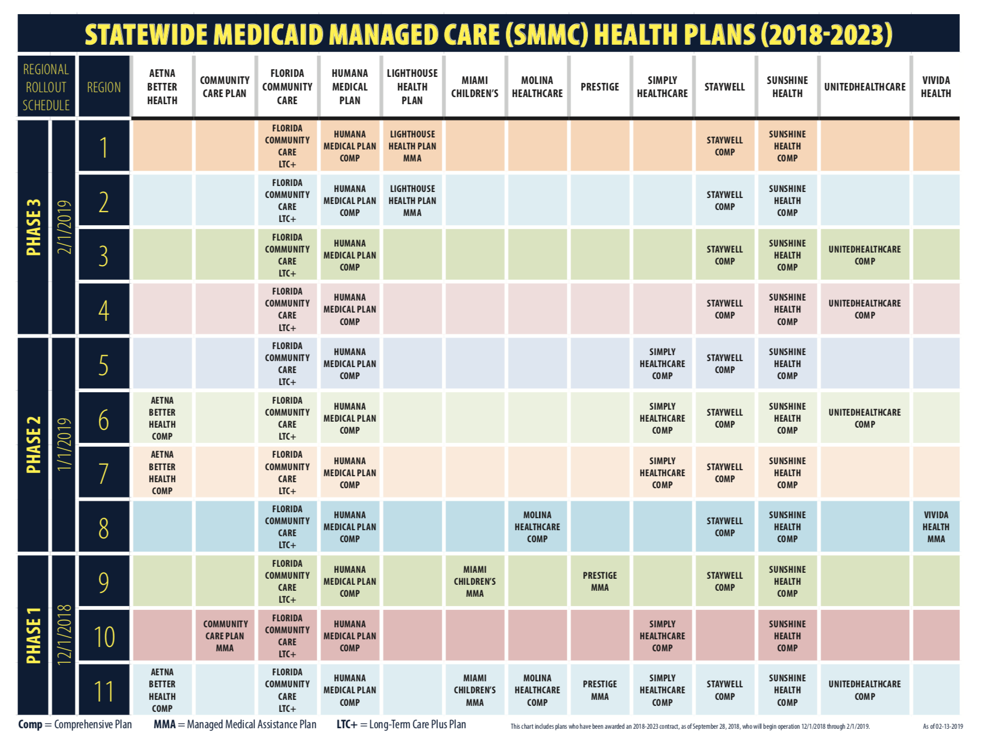
LTC Plans Florida

Slide 57
Plan Enrollment/Disenrollment
Finding Plans?
See Snapshot link, listing regions and plans
What happens if no choice?
Auto-enrollment
Disenrollment
Time Frame & Good Cause, FPI blog
Notes:
Heads up that plans are changing

Slide 58
What Specific Services Are Covered?
State statute
Contract
adult companion
attendant nursing care
assistive care
homemaking
HCBS services & “mixed” services

Slide 59
COVID-19 Service Changes
Participant Direction Option:
COVID change—Appendix K: Added respite services
Live-in Care Services:
Appendix K added
Assists with all activities of daily life
Plan recruits, trains and provides respite care

Slide 60
What Standard Applies in Getting Covered Services?
Medical necessity
General standard for Medicaid
Less restrictive standard for HCBS
Other coverage criteria
What is supplemental assessment?

Slide 61
Initial Visit/Care Planning
Initial visit within 5 business days
Develop care plan
Person Centered
Supplemental assessment
Review grievance and appeal rights
Right to participant direction option (PDO): Member chooses who, how, when of service provision
Pre COVID : adult companion, homemaker, attendant care, , intermittent and skilled nursing care, and personal care

Slide 62
Are There Time Standards for Receiving Covered Services/ Network Adequacy
What are network adequacy requirements?
Number of providers/Travel time
2 providers for each county; 30 minutes urban; 60 minutes rural
What are time standards?
“Reasonable promptness”: statute/ case law
Contract (Plan Duties Section)
Prior contract: required services begin within 14 days following initial visit
Current contract: no requirement in Plan Duties
Liquidated Damages Section: if failure to ensure within set time after visit for less than 85%

Slide 63
Right to “Gap” Plan
Contract protections against gap in services
Plan must prepare a “Service Gap Contingency and Back-Up Plan” for each enrollee
Plan must ensure that gap services are provided within a three- hour time frame.
Plan must discuss the plan with the enrollee, provide a copy to her/him, and ensure that the plan is updated quarterly
-Note: Workforce issues pre COVID; worse w/COVID

Slide 64
Alene
Reductions in Services & Gaps in Coverage
. . . despite getting her hours restored, she still has gaps in services. And COVID-19 has made it worse. For example, during one period in May, Alene went without any home health care for 3 days. One can only imagine what those 3 days were like: only being able to wash half her body and not being able to change clothes . .. .
After learning about the right to a Gap Plan, and asking her case manager for her copy, Alene told FHJP she has not had a problem.

Slide 65
Resolving Medicaid Managed Care Issues: Adverse Benefit Determinations/Other Issues
AHCA online portal or call
Grievance and appeal
Adverse Benefit Determination
Plan exhaustion
Expedited appeal standard
Time standard for resolution
COVID policy change: no need to exhaust at plan

Slide 66
Additional COVID Crisis Options: Increase LTC Waiver Slots (Appendix K)
Individuals on waitlist are at increased COVID risk due to age, poverty and medical conditions
Approximately 60,000 on the waitlist
Cost of nursing home 4X cost of LTC waiver
Dual benefit:
Supporting older adults at home (less risk of hospitalization or nursing home)
Supporting older adults in nursing home so that they can return to community with assistance and lessen risk of COVID

Slide 67
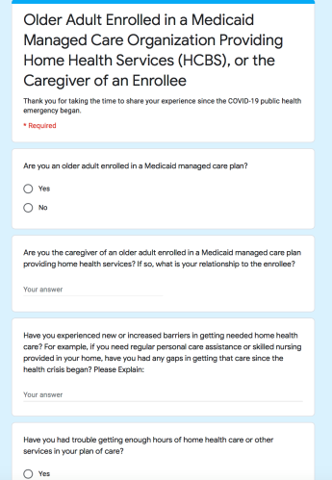
What Can Be Done
Share feedback supporting need for increasing slots and pay
Miami-DadeUnited Way led Older Adult Task Force, FHJP and multiple stakeholders created questionnaire
Forward Cover Email (feel free to edit) and Links for each stakeholder group

Slide 68
Other Advocacy Tools: Story Sharing

Slide 69
Manuel
Lingered for over 3 years on the Long-Term Care (LTC) waiver wait list
After an accident left Manuel unable to move or speak, or eat on his own, he was on the waiting list for over 3 years. His family took care of him at home because they did not want him in nursing home. But they had no training and couldn’t afford basic things he needed, including like diapers, which are not covered under regular Medicaid for adults.
Shortly after sharing his story, he did get enrolled in the waiver.

Slide 70
Therese II
Failure to Pay for Participant Directed Care
“We’re a close and loving family. Of course, I’m not going to let my sister Therese die or go into a nursing home; but we need my skilled nursing wages to pay the bills.”
Others….do people just die?
After sharing story through Project, and FHJP contacting plan lawyer, got payment problem resolved—and reimbursement for past unpaid wages.

Slide 71
Hypo #2
Masha is a 70 year old woman who has received SSDI/SSI and she got a notice that her full Medicaid would stop when her Medicare starts next month. The notice said she would get something called Q-I 1.
What if anything can you do during COVID crisis?
Notes:
Session 1 –refresher

Slide 72
Hypo #3
Jane’s daughter Mary calls your legal aid office about her Mom who suffers from severe dementia and is paralyzed. She was enrolled in a Comprehensive Plan, Plan X, effective June 18. Mary was pleased that a Plan X case manager came within the week on June 21 and prepared a plan of care that provided Jane with all of the home health care assistance that Mary and her mother’s doctor believe is needed, as well as other services.
However, it has now been over 3 weeks since the initial visit and Jane has only received a fraction of the home health care hours of services that were authorized and none of the skilled nursing services in the care plan.
Mary called the plan and they don’t disagree that Jane needs the authorized services and promise that they are trying to find a provider asap. They too say they are working on your mother’s case with Plan X. There is no notice of an Adverse Benefit Determination).
What can be done?
Notes:
failure to start services timely

Slide 73
Hypo #4
An investigative reporter calls you and asks your opinion on what is going on in Florida nursing homes. They are doing a series on Florida’s nursing homes, similar to the New York Times ‘dumping article’.
What do you do? Who do you call?
Notes:
Mike Ombudsman Program-
Slide 36 from session 1

Slide 74
Hypo #5
You work at a local senior center in Hillsborough County. It is temporarily closed due to COVID. But you are still working and one of your tasks is reaching out to seniors who used to come to the center for Adult Day Care and are now at home alone.
As one of the Counties using the new Florida Elder Law Risk Detector, you have it open on your laptop when you call the seniors that you used to see at adult daycare. You call Thomas, who was one of your clients prior to COVID and would come to your Center. He is an 84-year-old man enrolled in the LTC Waiver program. He is confined to a wheelchair, lives alone and needs assistance bathing and feeding himself. When you ask him the question: He tells you that he was approved for 35 hours a week of home health care, but when he switched plans his hours were slashed to 15.
What do you do next?
Notes:
Elder Risk Detector –

Slide 75
Hypo #6
Meg is a 74 year old woman enrolled in the LTC waiver program with Plan A, is confined to a wheelchair and requires assistance bathing, changing her clothes and is incontinent. She receives home health care from the company compassionate caretakers and her plan of care is approved for personal care for 40 hours a week. But, she often experiences gaps in coverage and is left alone because no home health aide shows up.
What can you do to advocate for Meg? What options are available in her plan?
5a-COVID) Meg’s sister is willing to move in and take care of her full time and they both want to shelter in place but her sister needs to earn an income. What are Meg’s options?
Notes:
Gaps in coverage

Slide 76
Hypo #7
Lee, age 59, had a massive stroke that impacted his cognitive functioning and ability to communicate. He cannot read or write and has memory and behavioral health concerns. He cannot manage his medications or banking independently, and relies on his pharmacy and bank to help him through complex systems. However, because of his limitations he still needs daily help. His PCP recommended a full time live-in aid.
After Lee applied for the LTC waiver and did not hear anything after his assessment for 2 months, he contacted your legal aid office.
You contacted DOEA, and AHCA and sent a copy of the notice he got that said that he got a “low priority score” and thus would not be on the wait list. It also included information on local resources and the right to request another assessment. It did not state anything about the right to appeal.
What can you do?
Notes:
priority score notice and appeal

Slide 77
Hypo #8
You work in your legal aid program’s housing unit and have been assigned a new eviction case of a client who is also in the LTC Waiver. Your client is a 62 year old man with significant physical disabilities (cannot ambulate or transfer independently). The supportive housing apartment complex where the man resides has given him notice of eviction for failing to maintain the cleanliness of his apartment.
The client is enrolled in the LTC waiver and has an assigned case manager. He receives house cleaning services 3x per week.
You want to find out if the LTC managed care plan can help your client/their enrollee in his current eviction case and avoid present and future eviction attempts?
Notes:
duties of plan to help

Slide 78
Upcoming Opportunities
ElderSource S.H.I.N.E. Program – Serving Health Insurance Needs of Elders
What it does:
Free and unbiased counseling about Medicare and health insurance benefits
Assistance during Open Enrollment to compare plans
Help with eligibility for prescription drug plans and premiums
Help with claims, billing, appeals and complaints
Information about Medicare scams
1-888-242-4464
Notes:
duties of plan to help

Slide 79
Thank You!
Please Complete Evaluation!
Questions/comments/suggestions please contact:
Miriam Harmatz: harmatz@floridahealthjustice.org
Katy DeBriere: debriere@floridahealthjustice.org
Melissa Lipnick: lipnick@floridahealthjustice.org
Session Materials Available Here

