Slide 1
Long-Term Services and Supports Through Medicaid Managed Care
Alliance for Aging, Inc.: New Face of Aging Conference
Miami, FL
March 14, 2019
Miriam Harmatz
harmatz@floridahealthjustice.org
Executive Director
Florida Health Justice Project, Inc.
www.floridahealthjustice.org
Notes:
Why this Guide? One of most confusng and most important benefits in Medicaid program; as population ages, need increases way over half of us need at one time or another—hard enough on middle class, perhaps can pay for out of savings—but for low income—grave risk of institutionalization ; not covered by Medicare
illustrates couple of the overriding issues in health care system as whole—FLs Medicaid program underfunded by state leg—a problem exacerbated by the fact that the state has not yet expanded Medicaid; and the wait list for these services, also exacerbate by non expansion because those on the WL between xx and xx of FPL would be on regular Medicaid if/when state expands, and for regular Medicaid enrollees. home health services are available

Slide 2
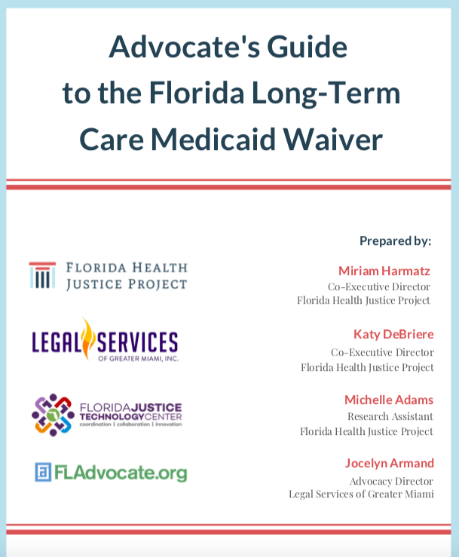
r

Slide 3
On-line Web Based Guide
Notes:
So FHJP did this guide, along with o author LSGMI. Note at outset, got lot of tech assistance help form the state and national experts in xxxxx and help with review form people who had much more first hand expertise with the benefit, including EC , NW, AS, VG. And asked version so …..was released last week and on all our websites, so you don’t need to take extensive notes today. And instead we can just go through and highlight some issues and put pins in some things that would be worth following up on with partners between ADRCs, legal services and others.
Also want to note that in the Guide today, when refer to LTC waiver, we are only talking about that part that involves HCBS—not nursing home care.

Slide 4
Home and Community Based Services (HCBS)
What are they?
Services needed to “meet functional needs and remain in community.”
How are they different from other Medicaid services?
Not entitlement
How are they provided in Florida?
Long Term Care Program Waiver
Notes:
LTSS—also referred to as HCBS are those services like home health aides, that are essential for people who are so frail and/or disabled who would otherwise need to be in institution
Different from regular Medicaid 2 ways: 1) not “medical "therefore not “covered under section of Medicaid Act that defines the medical services states must cover such as Rx, hospital services, doctors; HCBS by contrast include things like home health aide—; 2) there fore, have been made available by “waiving” that section of the Act defining medical services; and 2) they are not an “entitlement” unlike other parts of the Medicaid program where states must provide coverage and services to everyone who meets eligibility requirements.
IN Florida, HCBS are provided through managed care plans to eligible individuals. Virtually all of FL's Medicaid services are provided through managed care., including long term care, which includes both nursing home care and HCBS.
Why we did this Guide

Slide 5
What authority governs the LTC Waiver?
See, Advocates Guide, section 15
Federal statute
Federal regulations (C.F.R.)
State statute
State rule (F.A.C.)
Waiver application and approval
Agency for Health Care (AHCA)Model Contract
Contract LTC attachment
DOEA Program Manual

Slide 6
Background
What are Medicaid Waivers?
See also, Advocate’s Guide to the Florida Medicaid Program
History
What was Waived and Why ?
“The purpose of the Long-term Care waiver is to provide choice of long-term home and community – based services for eligible and disabled adults in Florida as an alternative to nursing facility services for their long- term care . . . to provide incentives to serve recipients in the least restrictive setting . . .and [to] improve[] access to care and quality of care.”
Notes:
Broadly speaking a “waiver" 'request is when the state medical program asks the federal govern for permission to “waive” certain parts of the Medicaid statute. And will take opportunity here to alert folks to another Guide FHJP did with FJTC, on the Medicaid program, which explains how Medicaid is a joint federal state program. The federal govt provides most of the funding and the federal Medicaid statute sets forth the general requirements for states in order to get that funding. Lots of state flexibility, including opportunity to request these “waivers” .
The LTC waiver waived several requirements in the Medicaid statute, including the finiancial limits (so a bit higher than for regular Medicaid); type of services—so did not have to be purely “medical “ in nature; freed to choose providers, which allowed state agency to require that people enroll in a managed care plan with limited network; that services be available statewide.
History set out in the Guide, so won’t spend item on other than to read what the Medicaid agency stated in their waiver requests:

Slide 7
Overview of Guide
Who is eligible?
How to apply?
What to do if application denied or delayed?
How does waiting list work?
What to do if eligibility is terminated?
What services are covered and how is care plan developed?
How does managed care work?
What to do if services are delayed, denied, terminated or reduced?
Notes:
Had 2 major goals in doing guide—we wanted to have a road map that would provide the context and brief discussion around each of these points AND we wanted to provide all of the citations to the underlying legal authority for the Waiver. It’s an occupational hazard of lawyers that we just like to see all the legal sources, and how those sources connect in –particularly and what authority should I be looking at if I’m trying to help a frail or disabled client either get into the waiver or get services once in the waiver we can look at this Guide and figure out the basis for pointing out, typically to the MCO or AHCA, why someone needs to do x, y , or Z for my client.

Slide 8
Program Overview
Agencies involved
Agency for Health Care Administration (AHCA)
Department of Elder Affairs (DOEA)
Department of Children and Families (DCF)
Populations covered
Role of managed care plans

Slide 9
Major Changes to the New LTC Contract
New Plans
Enhanced Benefits
Increased LTC Transition
Medicaid Pending
SIXT Period
Member Handbook
Good Cause Disenrollment
Time Standards

Slide 10
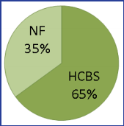
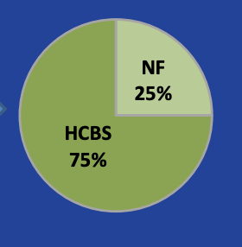
Increased LTC Transition to Community
Prior Contract
New Contract

Slide 11
What are the Application Steps?
Initial assessment
What is the priority score?
What does ranking (1-8) mean and how does it work?
Who ranks above 5 regardless of priority score
Wait list
What does release mean?
What happens after release?
Determining clinical and financial eligibility
Who Is exempted from initial assessment and wait list?
Notes:
Note on financial: many low income clients who desperately need the service , meet the clinical guidelines but are still over income and need assistance with an income trust. This is something I never did in all my years at LS; I know it’s important and know there is great need and demand form frail and disabled who cannot afford a Medicaid planning attorney. Tecumseh Myles, the xxx at LAPBC is going to talk briefly during lunch panel about how her program provides that service

Slide 12
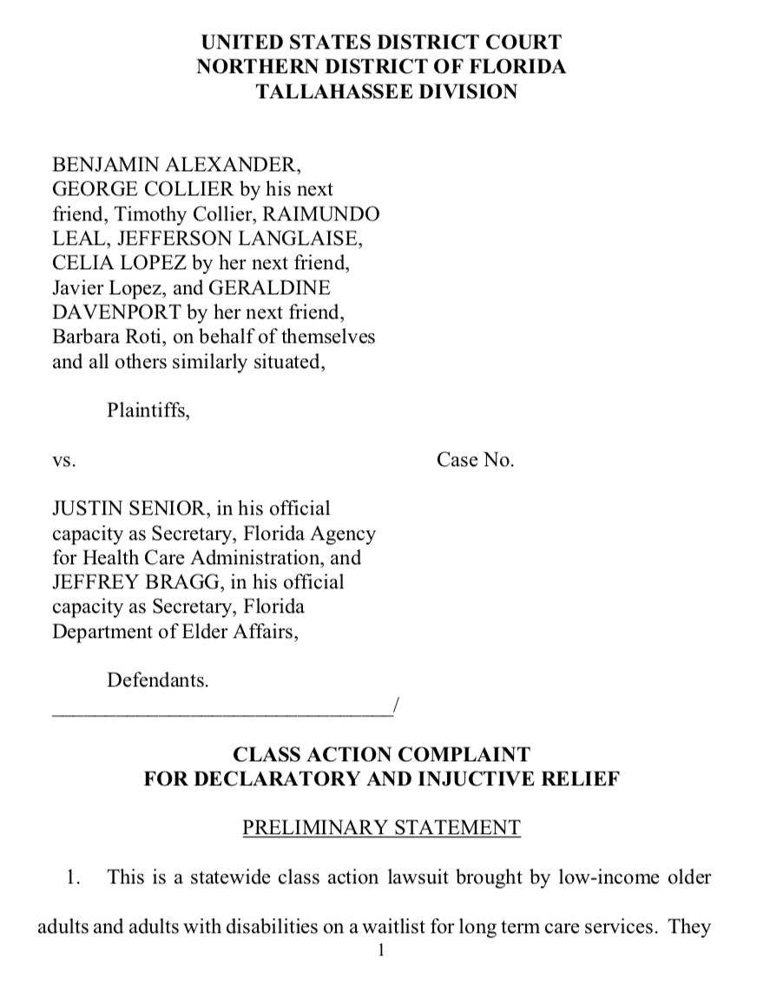
Wait List: Class Action

Slide 13
Wait List: Class Action
Americans with Disabilities Act Class Action suit in the Northern District
Case No: 4:18-cv-00569-RH-MJR
Class Counsel Contact: Regan Bailey
Rbailey@justiceinaging.org

Slide 14
What if Application is Denied or Delayed?
Initial Assessment/Priority Rank
Appeal to AHCA –Medicaid Hearing Unit
After Released from Waiting List
Appeal to DCF
Notes:
Challenge in finding authority

Slide 15
”Medicaid Pending”
Medicaid Pending; Prior Contract
Required that the plan must authorize and provide services to “Medicaid Pending” enrollees.
Current Contract
Not required

Slide 16
What Plans are Now Available?
Managed Medical Assistance (MMA)
Not available for those eligible for LTC services
Long Term Care Plus (LTC+)
MMA services + LTC services
Not available to those only eligible for MMA
Comprehensive
MMA Services + LTC services
Specialty
Dental

Slide 17
New Region 11 LTC Plans

Slide 18
Plan Enrollment
Finding Plans?
See Snapshot link, listing regions and plans
What happens if no choice?
Auto-enrollment
Notes:
Heads up that plans are changing

Slide 19
Dental Benefit
Dental is a new benefit
Adult package includes diagnostic, preventative, and restorative periodontics
All full-benefit recipients are required to enroll, with a few exceptions
See SMMC: Overview Presentation at 34

Slide 20
What Specific Services Are Covered?
State statute
Contract
adult companion
attendant nursing care
assistive care
homemaking
HCBS services & “mixed” services

Slide 21
Expanded Benefits
For a full list of expanded benefits, see the SMMC: Overview Presentation at 21-22
Notes:
Heads up that plans are changing

Slide 22
Member Handbook
Prior Contract:
the role of the case manager;
how to access a case manager and services;
the assessment or re-assessment process;
the person-centered planning process;
local education and consumer resources;
participant direction for certain services; and
how to access information including the case file.
“The purpose of the LTC program is to provide you with an array of services that meet your needs and allow you to live in the setting of your choice. This includes allowing you to live in the community for as long as you choose.”
Current Contract:
None of language above
Federal regulation is cross referenced

Slide 23
Care Planning
What is the person centered planning process?
What is the process?
What is the plan?
What is the supplemental assessment?
What is the role of case management?
What are participant directed services?

Slide 24
What Coverage Standard Applies?
Medical necessity
What is the general standard in Florida?
What is the standard for HCBS
Other coverage criteria
What is supplemental assessment?

Slide 25
Florida’s Definition of Medical Necessity
1) Be necessary to protect life, to prevent significant illness or significant disability, or to alleviate severe pain;
2) Be individualized, specific, and consistent with symptoms or confirmed diagnosis of the illness or injury under treatment, and not in excess of the patient’s needs;
3) Be consistent with generally accepted professional medical standards as determined by the Medicaid program, and not experimental or investigational;
4) Be reflective of the level of service that can be safely furnished, and for which no equally effective and more conservative or less costly treatment is available statewide and;
5) Be furnished in a manner not primarily intended for the convenience of the recipient, the recipient’s caretaker, or the provider.

Slide 26
Medical Necessity Definition for HCBS
Be individualized, specific, and consistent with symptoms or confirmed diagnosis of the illness or injury under treatment, and not in excess of the patient’s needs (# 2);
Be reflective of the level of service that can be safely furnished, and for which no equally effective and more conservative or less costly treatment is available statewide (# 4) and;
Be furnished in a manner not primarily intended for the convenience of the recipient, the recipient’s caretaker, or the provider (# 5).
And, one of the following:
Enable the enrollee to maintain or regain functional capacity; or
Enable the enrollee to have access to the benefits of community living, to achieve person-centered goals, and to live and work in the setting of his or her choice.

Slide 27
What are the Standards for Continued Coverage?
What to do if gaps in coverage?
Contingency and back up plan/Cannot rely on ”informal support”
What are prescribing and continuing coverage requirements?
6 months for maintenance therapy

Slide 28
“SIXT” Period
Prior Contract
Authorized enrollees who lose Medicaid eligibility to continue enrollment and plan for sixty days – the SIXT Period.
Plan was required to continue providing services during the SIXT Period.
Continued enrollment for 60 days after ineligibility.
Current Contract
Not required

Slide 29
Network Adequacy /Time Standards
What are network adequacy requirements?
Number of providers/Travel time
2 providers for each county
30 minutes urban
60 minutes rural
What are time standards?
“Reasonable promptness”: statute/ case law
Contract
Prior contract: Begin services within 14 days following initial visit
Current contract No beginning services time frame
Still in liquidated damages

Slide 30
Enrollee Issues: AHCA Complaints, Plan Grievances
AHCA online portal or call
Difference between grievance and appeal
Expedited appeal standard
Time standard for resolution

Slide 31
What if Services are Denied, Delayed, Reduced or Terminated?
Notice of Adverse Benefit Determination
Appeal (exhaustion requirement)
Can be expedited
Fair hearing
Discovery
Right to continued coverage
Notes:
Complaint to AHCA also important

Slide 32
Changing Plans/Disenrolling
Changing plans for any reason/ or no reason
120 days after enrollment
Changing for “Good Cause”
Specific circumstances
General circumstances: must first seek resolution with the plan (“exhaustion”)
lack of access, poor quality care
exception: emergency

Slide 33
Good Cause Authorities
Federal Law
Regulation: 42 C.F.R Sec. 438.56
Florida Law
Statute: Sec. 409.969(2) F.S.
Rule: 59G-8.600(b) F.A.C.
Contract: Prior Contract
Expansive list

Slide 34
Other Consumer Protections
Enrollee Advisory Committee
Plans required by contract
Meets at least twice a year:
consider issues
obtain feedback from Plan
Submits minutes to AHCA
Including Plan’s response to identified concerns
Independent Consumer Protection Program (ICSP)
Required under LTC waiver agreement
Coordinates efforts between relevant agencies
Goal is to help enrollees understand and resolve service coverage and access complaints

Slide 35
THANK YOU!
Questions; comments; suggestions:
Please contact:
Miriam Harmatz
harmatz@floridahealthjustice.org
Executive Director
Florida Health Justice Project, Inc.
www.floridahealthjustice.org

